Slide 1
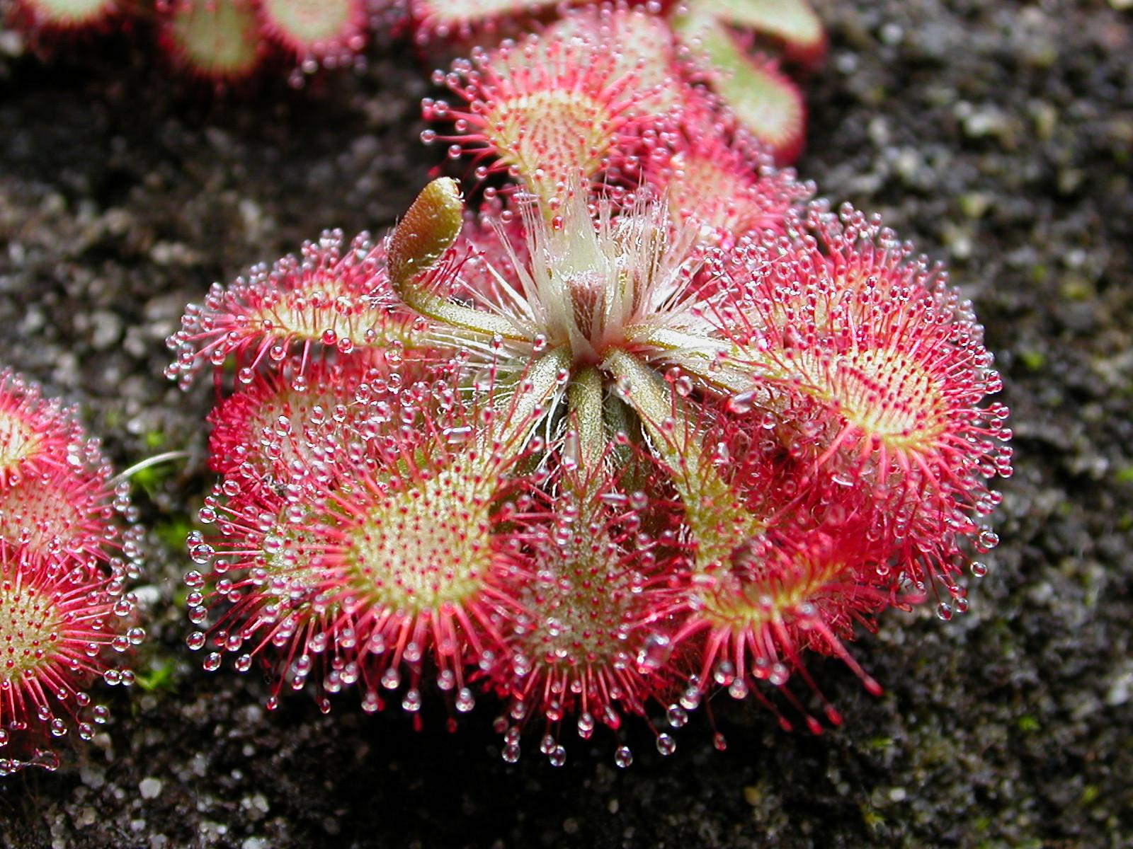
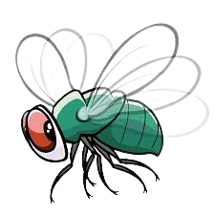
CORRECT!
This is a Sundew!
NEXT

Slide 2
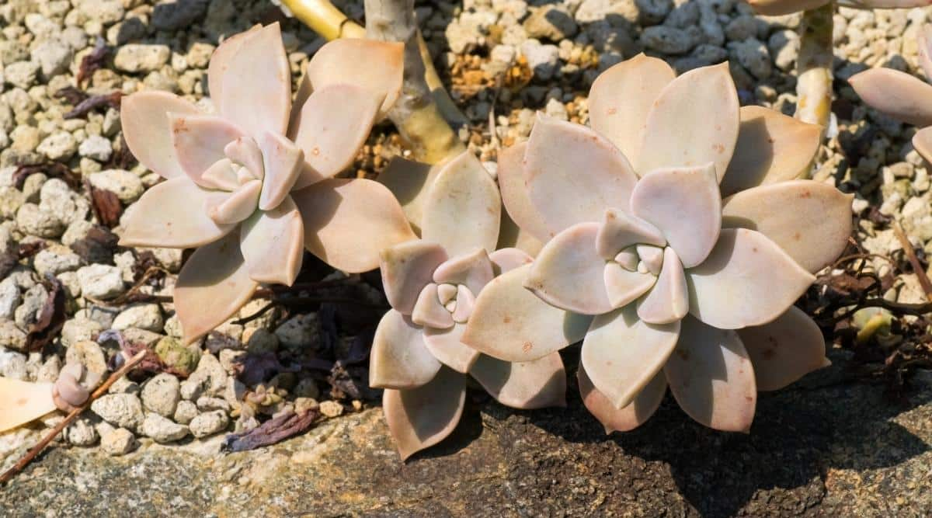
YES
Is this a Butterwort?
NO

Slide 3
Incorrect
Press the button to try again.
TRY AGAIN!

Slide 4
CORRECT!
This is a Ghost Plant!
NEXT

Slide 5
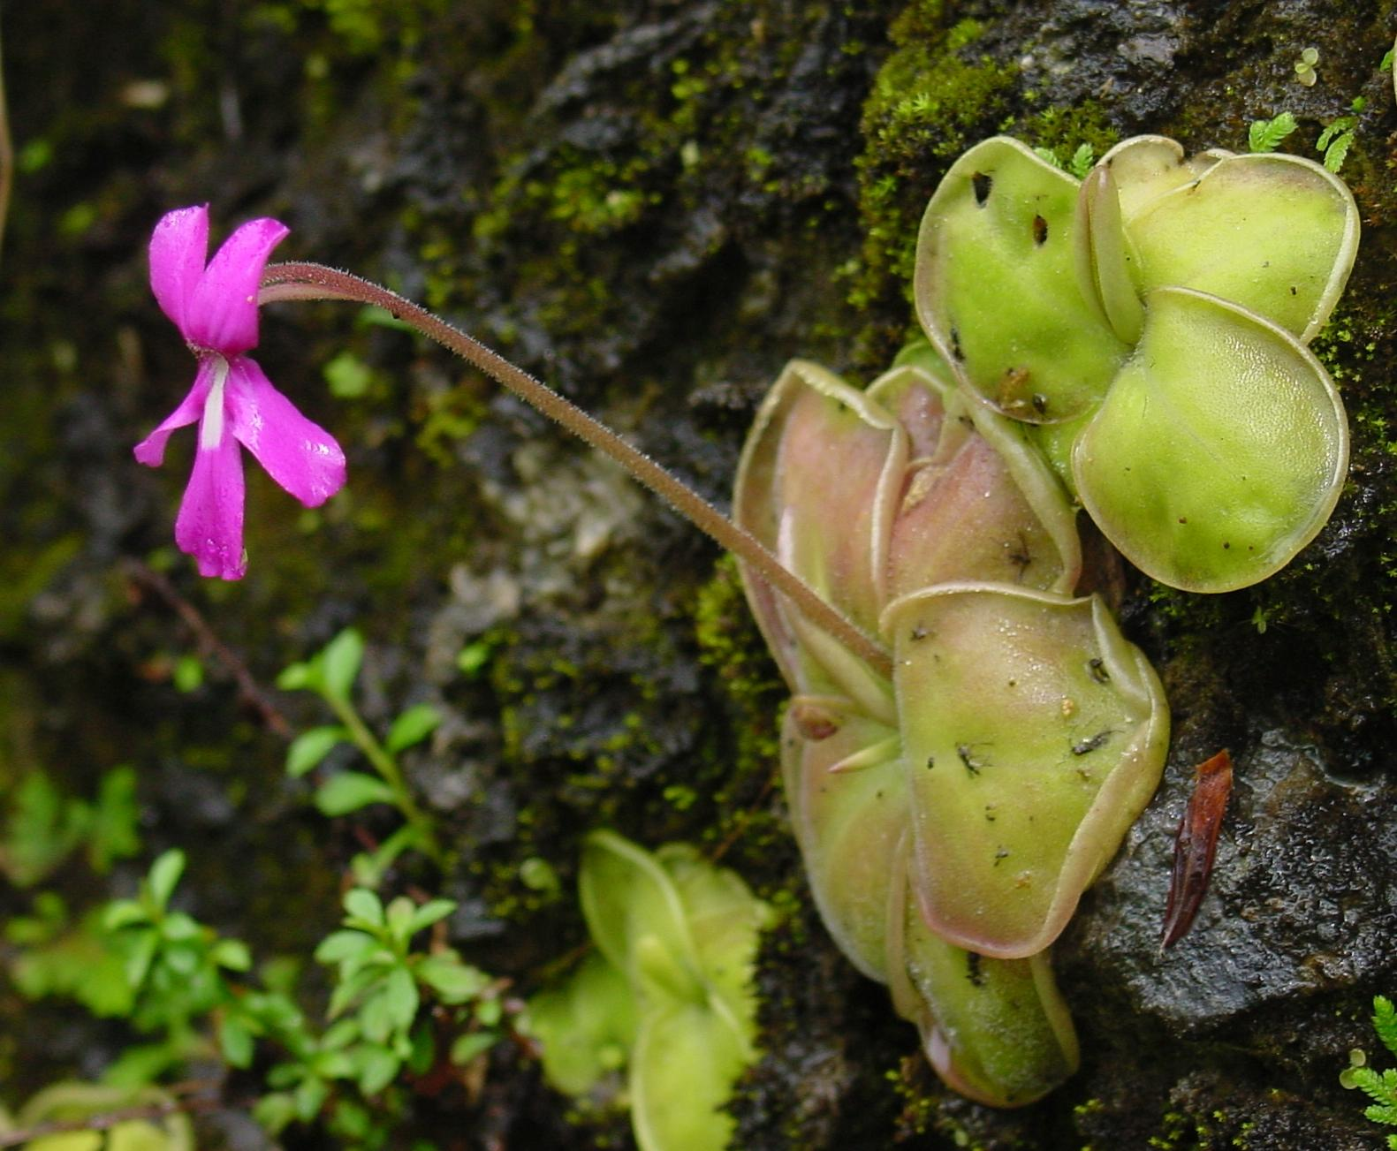
YES
Is this a Butterwort?
NO

Slide 6
Incorrect
Press the button to try again.
TRY AGAIN!

Slide 7

CORRECT!
This is a Butterwort!
Click here to
return to The Bog

Slide 8
You shouldn't be here!
Go back to the bog!!!

Slide 9
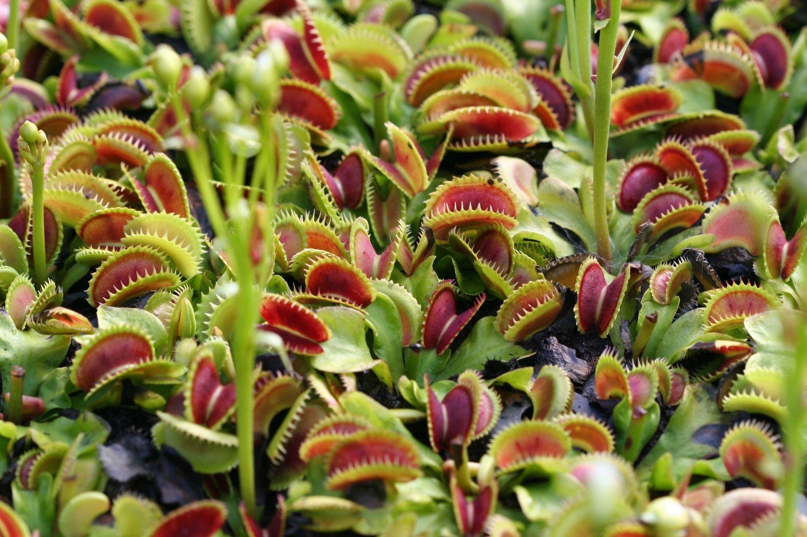
What did the Venus Flytrap
say to the waiter?
Uh, yes... I'll have a cheeseburger with flies.
Notes:
Secret Page Shhhhh!

Slide 10
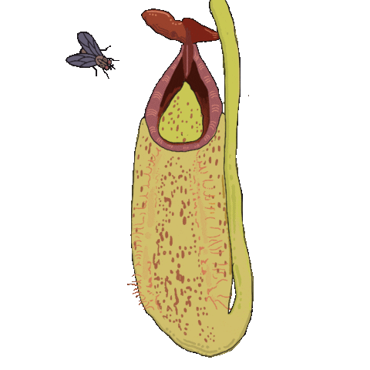
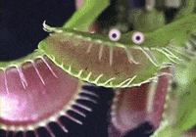
CONGRATULATIONS!
We survived our trip through a carnivorous plant bog.
Thanks for playing!
PLAY AGAIN!
Notes:
Help frog through a maze?

